Slide 1
Manifold Review
Why does the last port on the sedimentation tank inlet manifold have the highest flow rate?
To achieve more uniform flow distribution between ports in a manifold should you increase or decrease the manifold diameter?
Could you improve the flow distribution by tilting the manifold to maintain a more constant pressure in the manifold?
Notes:
In which kinetic energy becomes important!
It’s about piezometric head AND must account for kinetic energy converted to pressure.

Slide 2
Design Projects
Draft Friday at 11 pm
Final presentations on 5/7
Send me PowerPoint or Google slide link by 10 am on 5/7
10 minutes per team
Don’t mess up on the timing!
Practice!
Make it educational and fun for your classmates!

Slide 3
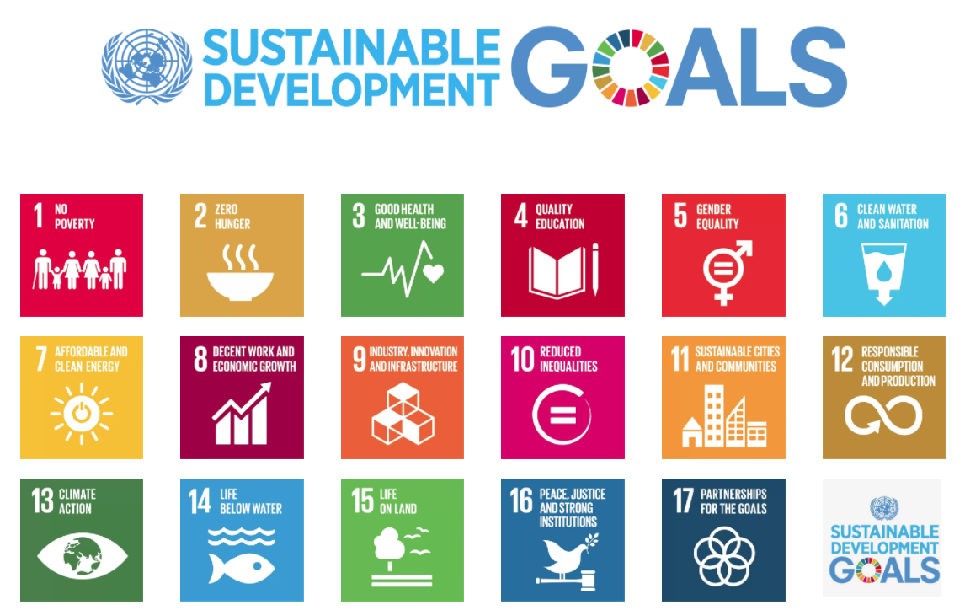
2015 to 2030
Notes:
On 1 January 2016, the 17 Sustainable Development Goals (SDGs) of the 2030 Agenda for Sustainable Development — adopted by world leaders in September 2015 at an historic UN Summit — officially came into force. Over the next fifteen years, with these new Goals that universally apply to all, countries will mobilize efforts to end all forms of poverty, fight inequalities and tackle climate change, while ensuring that no one is left behind.
http://www.un.org/sustainabledevelopment/development-agenda/

Slide 4

At least 1.8 billion people use a source of drinking water contaminated with feces
More than 80% of wastewater is discharged without any pollution removal

Slide 5

SDG 6.1: By 2030, safe and affordable drinking water for all
Some three in ten people (2.3 billion) lack access to safe and readily available water at home
Additional 1.2 billion from population growth gives 3.5 billion need water by 2030
267 million people per year! (1 Indonesia/year)
At 3 mL/s per person we need 800,000 L/s per year of new installed capacity
Notes:
http://www.un.org/sustainabledevelopment/blog/2017/07/billions-around-the-world-lack-safe-water-proper-sanitation-facilities-reveals-un-report/

Slide 6
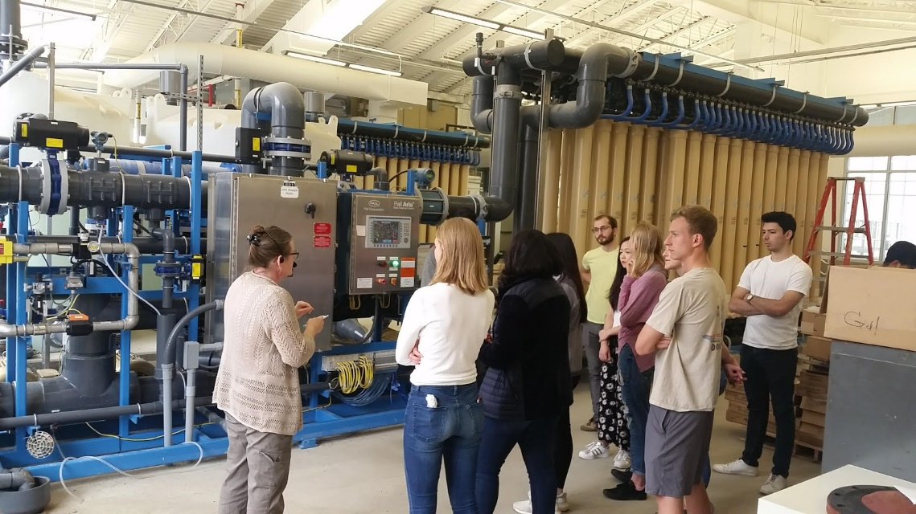
US Water Infrastructure
ASCE Infrastructure Grade is D+
What you’ve learned in this course is completely applicable to designing new and upgrading existing water treatment infrastructure anywhere on this planet

Slide 7
Why don’t countries prioritize building water supply systems and drinking water treatment plants?
Notes:
Maybe they are making a rational decision!
If investing in drinking water supply seems to only result in more problems, then why bother?

Slide 8
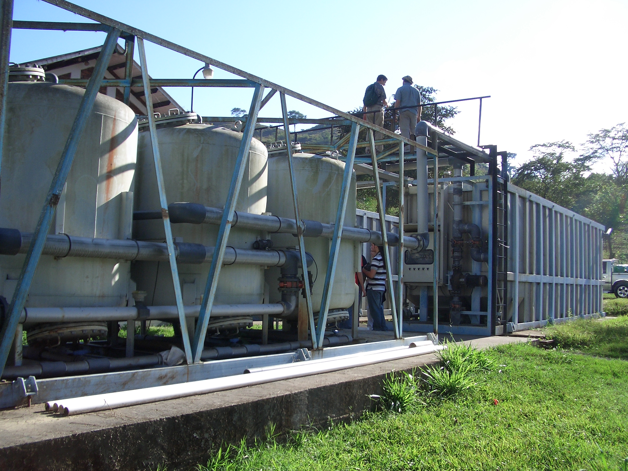
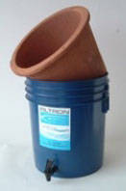
Traditional solutions aren’t performing well in the majority world
Decentralized – household and Kiosk
Centralized – Municipal scale
“advanced technologies”
Don’t provide water access
No monitoring
Require every household to invest time in maintenance and operation
High part count
High capital and maintenance costs
High energy use
Frequently provide poor water quality

Slide 9
Centralized water treatment has often failed in the majority world
Frequent failures due to high component count
Short life of water treatment infrastructure
20 years for high tech plant in Nicaragua
About 10 years for high tech plants in Honduras
3 years for high tech plants in Africa (World Bank experience)
So if you were a politician would you want to invest in water treatment plants?

Slide 10
Centralized water has a bad reputation!
“…relying only on time- and resource-intensive centralized solutions such as piped, treated water will leave hundreds of millions of people without safe water far into the future.
Self-sustaining, decentralized approaches to making drinking water safe, including point-of-use chemical and solar disinfection, safe water storage, and behavioral change, have been widely field-tested.”
Eric MintzMD, MPH, , Jamie BartramPhD, , Peter LocheryMSc(Eng), and , Martin WegelinMSc
Notes:
http://ajph.aphapublications.org/doi/abs/10.2105/AJPH.91.10.1565

Slide 11
AND!!!!
Centralized water supply systems are imperative for healthy towns and cities
Resilient centralized systems are often the best option
Where do decentralized systems get their water?
Centralized systems that perform poorly can spiral to failure

Slide 12
Resilient Designs are needed in the United States too!
NYC blackout of 1977
Boeing Max 8 substituted a stable aeronautic design for software feedback control
Design for steady state (cruising at flight elevation) is easy
Design for rapid startup after disasters is much harder
What guidelines would you suggest for resilient water treatment plant design?
Notes:
Manual operation fully enabled (Max 8 lesson)
Use physics rather than software to enable reliable operation
Smart hydraulics (example of StaRS flow control system)
https://theaircurrent.com/aviation-safety/what-is-the-boeing-737-max-maneuvering-characteristics-augmentation-system-mcas-jt610/
By moving the larger and more fuel efficient engine slightly forward and higher up they increased fuel efficiency by 14%
Caused an increased moment on the aircraft causing it to tend to rotate the nose up.
Connect water treatment plant design to Max 8 aircraft.
Separate control and monitoring

Slide 13
Centralized treatment CAN work if we adopt a new approach!
Engineering that focuses on Economics, Energy, Equality, Elegance, and Efficacy
Low cost AND High performance are possible
$12 per year per person for operation and maintenance
$50 per person for capital costs
3.5 billion need water - $175 billion capital cost by 2030 ($13.5 billion/year)
Similar to US ice cream purchases
Centralized can be monitored for safety

Slide 14
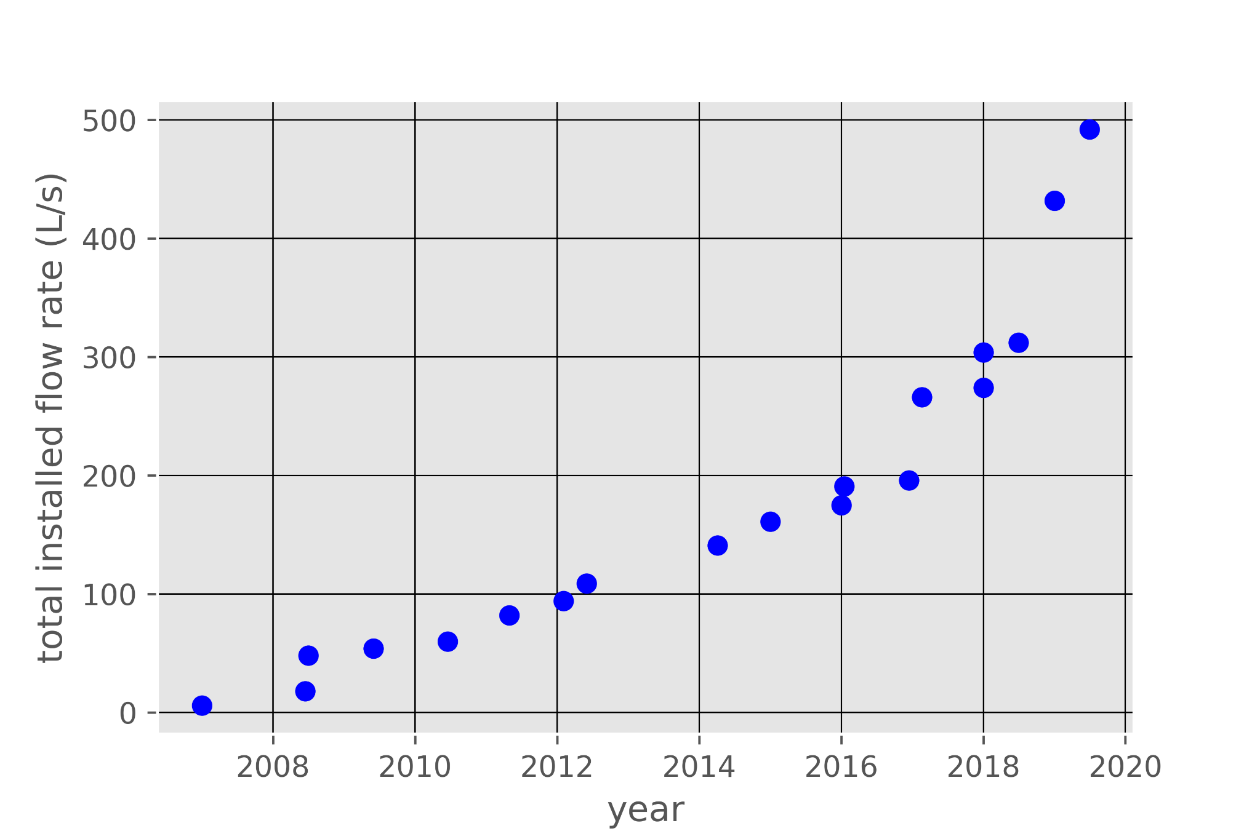
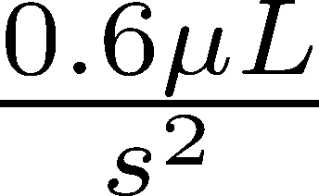
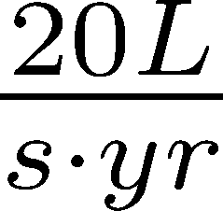
AguaClara installed capacity is increasing steadily (and slowly)

Slide 15
Time for acceleration
We need 800,000 L/s per year of new installed capacity
AguaClara = 20 L/s per year – need to increase rate by a factor of 40,000
Disruptive technologies must be at least twice as good as traditional technologies (marketing is critical too!)
Our ongoing research to improve water treatment technologies is critical to increase the rate
Open source engineering is also a disruptive new approach to spreading technologies

Slide 16
The transition is underway with a significant increase in rate!
Ocotal
Gracias
San Rafael del Norte
Zamorano
La Concordia
Las Vegas

Slide 17
Challenges on the horizon
Standard designs for flow rates from 1 to 240 L/s
Retrofit designs for larger flat bottom sed tanks (take the case of 10 m square tanks)
Wide range of water contaminants (expand to fluoride, arsenic, wastewater, reuse)
Biggest challenge of all – create enough momentum so that new technologies are adopted and sustained

Slide 18
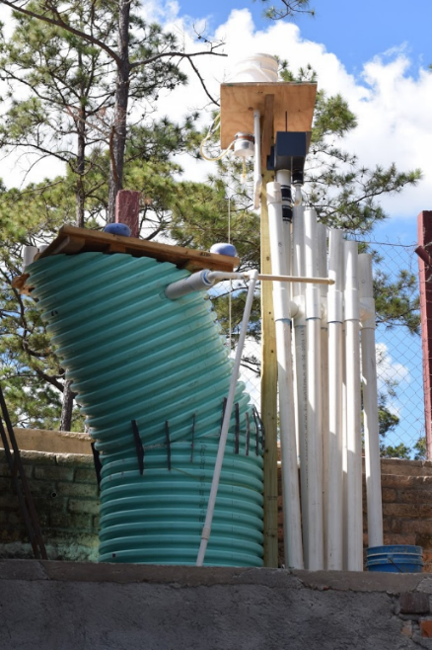
New Opportunities
Million village challenge
Possibly adapted to remove arsenic and fluoride
Demonstrate new technologies at far lower cost ($10k rather than $100+k)

Slide 19
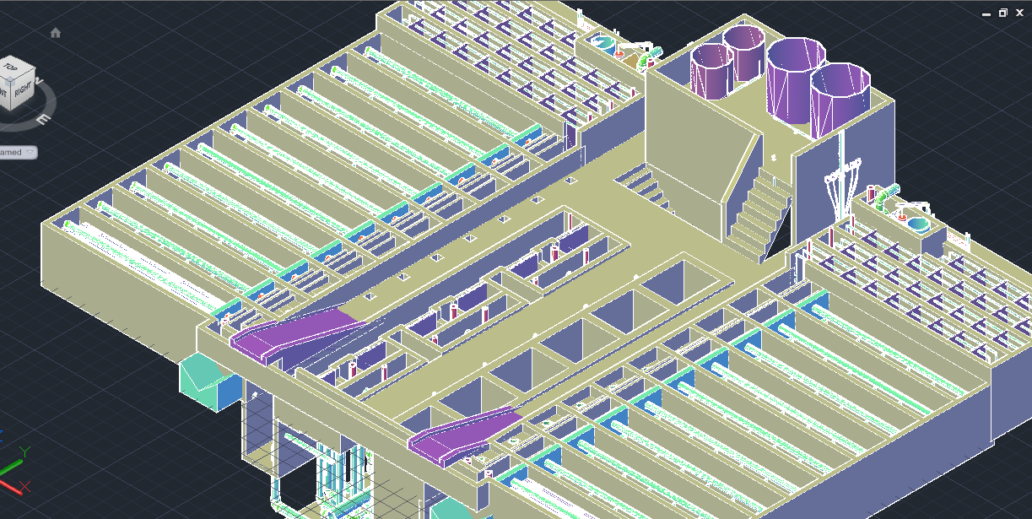
120 L/s AguaClara plant (draft design for Gracias, Honduras)
Meghan Furton M.Eng. 2017

Slide 20
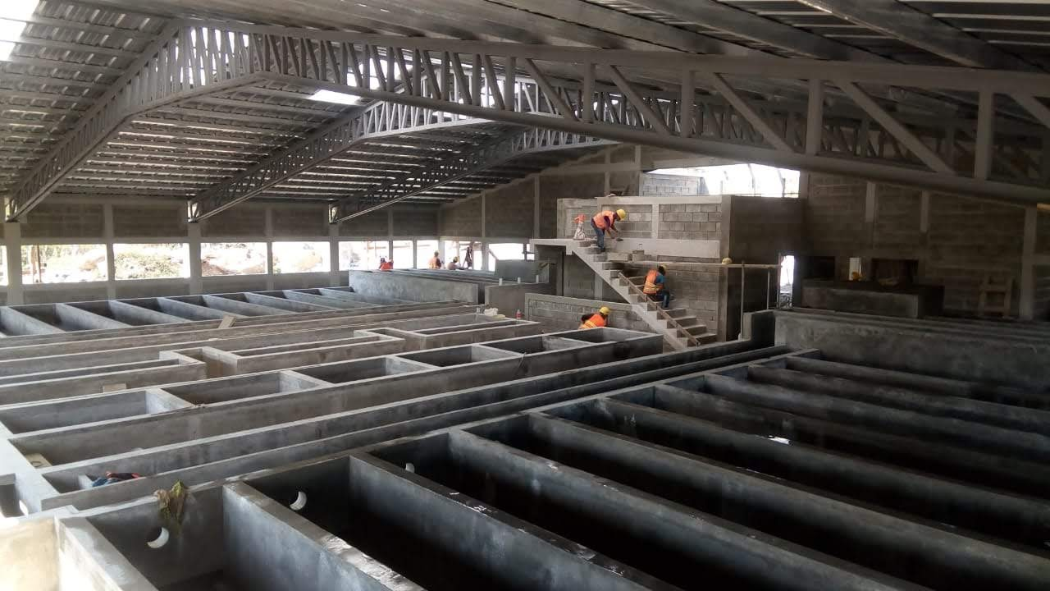
Gracias on April 12, 2019

Slide 21
Course Reflections?
What is one thing that you learned (or that you’ve valued) in this course that you want to always remember?
Notes:
Write it on the board?

Slide 22
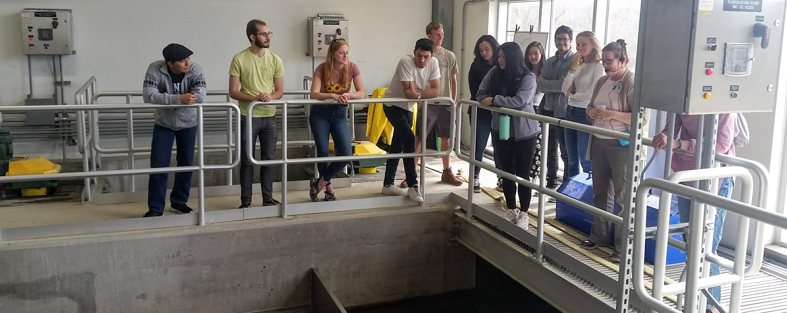
You conquered Atom, Markdown, Python and the AguaClara package
You demonstrated your ability to learn with minimal guidance
You are wonderful people! Thank you!
Jillian and Matt are amazing people and outstanding teachers

Slide 23
Connecting Meaning to Graduate School and Professional Careers
Four steps toward a better world
Measure stuff (often sufficient for a Ph.D.)
Create models of how our universe works (based on observations) (fundamental science)
Invent new solutions based on good models of how our universe works (inventing!)
Engage with the world to implement those solutions (engineering!)
Our planet needs bold engineers and scientists who engage to create a better world
Engaging with real world problems facilitates inventions
Notes:
You can get a Ph.D. doing step 1 sometimes.
Step 2 is great for getting a Ph.D.
Steps 3 and 4 are much harder!

Slide 24
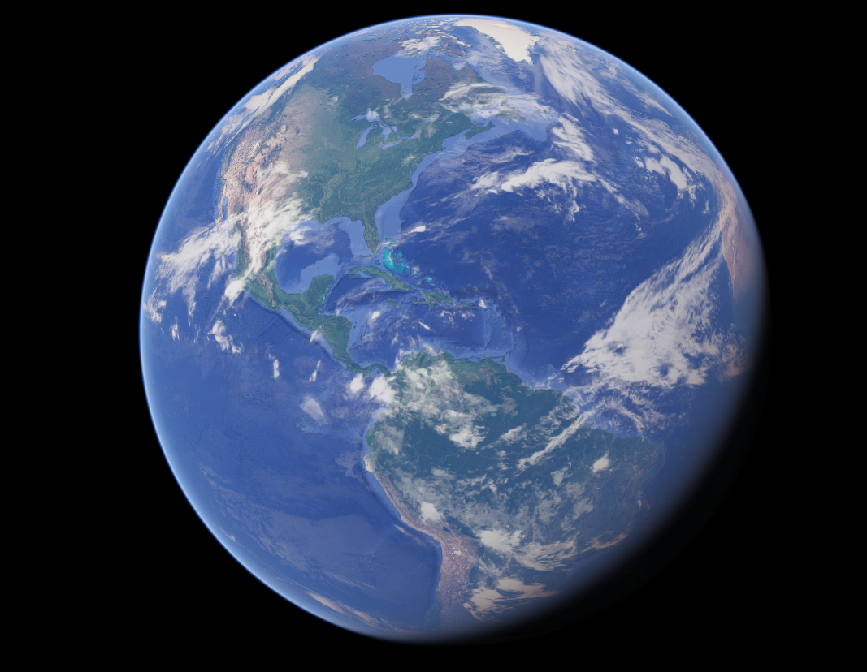
Engineering is Love

